Slide 2
Classroom

Slide 3
Pencil

Slide 4
Pen

Slide 5
Crayon

Slide 6
Paper

Slide 7
Book

Slide 8
Ruler

Slide 9
Scissors

Slide 10
Notebook

Slide 11
eraser

Slide 12
Pencil Sharpener

Slide 13
Desk

Slide 14
Blackboard

Slide 15
Computer

Slide 16
Chair

Slide 17
backpack

Slide 18
folder

Slide 19
pencil case

Slide 20
paperclip

Slide 21
calculator

Slide 22
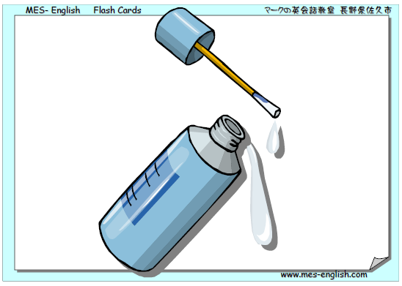
Whiteout / corrector pen

Slide 23
notepad

Slide 24
stapler

Slide 25
hole punch

Slide 26
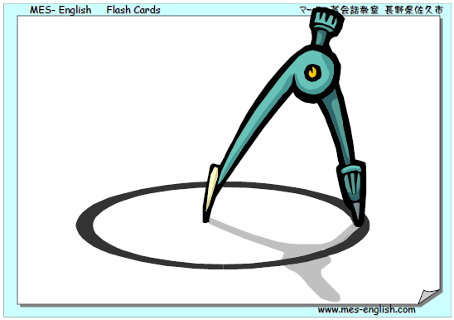
compass

Slide 27
glue

Slide 28
bulletin board

Slide 29
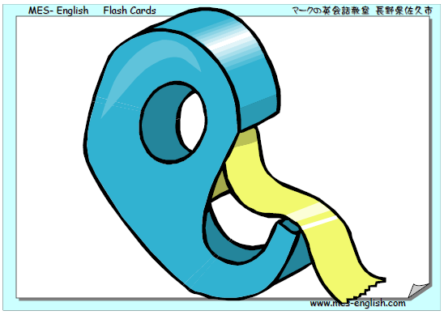
tape

Slide 30
paint

Slide 31
paintbrush

Slide 32
calendar

